Slide 1

HERMES
The model is one
component.
The system does the work.
How I built an agentic operating system around my actual work
Rob Dickson | AI Superusers | Newman University | July 28, 2026
Notes:
Open with the destination, not the product tour. I am not here to show every Hermes feature. I am here to show how the system around a model makes AI dependable enough to become part of real work. The model is important, but it is one component. Context, tools, skills, schedules, state, verification, and approval are what turn a strong response into a repeatable operating system.

Slide 2
OPENING
5 MIN
How many of you have had an excellent AI conversation...
that produced absolutely nothing reusable the next day?
Great conversation.
Gone tomorrow.
02
Notes:
Ask for a show of hands. Let the room react. Then tell the short progression story: one-off prompts were useful, but repeated work exposed the limits of generic instructions and chat history. I started moving stable facts into memory, repeatable judgment into skills, and recurring work into scheduled processes. The surprise was that more automation initially created more noise. The work became useful only after adding filters, state, verification, and explicit permission boundaries. The goal was not to make AI busier. It was to make my work calmer.

Slide 3

FROM CHAT TO SYSTEM
7 MIN
A chatbot answers.
A system remembers.
KNOWS
the person and the job
ACTS
through tools on real systems
LEARNS
through reusable procedures
RUNS
on triggers and schedules
PROVES
what happened
03
Notes:
Define the category. Hermes is an open-source, provider-agnostic agent framework that can run in a terminal, a WebUI, and messaging platforms. The useful distinction is not chat versus a bigger chat. It is a response versus a system that knows the job, retrieves context, uses tools, follows procedures, runs repeatedly, preserves state, and verifies results. This is the mental model for the rest of the session.

Slide 4

THE STACK
Seven layers make it dependable.
1
Person + purpose
2
Context + constraints
3
Skills + instructions
4
Tools + models
5
Schedules + subagents
6
State + knowledge
7
Verification + approval
04
Notes:
Walk down the stack. Person and purpose tell the system what matters. Context and constraints prevent generic advice. Skills preserve procedures and judgment. Tools and models let the system inspect and act. Schedules and subagents orchestrate recurring or parallel work. State and knowledge prevent amnesia. Verification and approval protect trust. The short distinction to repeat is: memory stores facts, skills store procedures, scheduled tasks execute procedures, and tools touch reality.

Slide 5
MY SETUP
10 MIN
Local. Routed. Mostly quiet.
Mac
local execution
49
117
Gateway
always running
installed skills
active scheduled tasks
Telegram
mobile surface
Reusable procedures for research, publishing, operations, documents, and maintenance.
GPT-5.6
primary conversation
Other models
task-fit routing
The count is not the accomplishment. The filtering is.
05
Notes:
Give the current snapshot, then immediately de-emphasize the vanity metrics. Hermes runs locally on my Mac. The gateway runs continuously. Telegram is the primary mobile surface, with the WebUI and terminal for longer work. GPT-5.6 is the main conversational model, while scheduled tasks can use other models based on task fit and cost. There are currently 49 active scheduled tasks and 117 installed skills. Most scheduled tasks are upstream and local. They do not all notify me. The accomplishment is not the count. It is that collection, synthesis, and delivery are separated.

Slide 6

THE RESEARCH SYSTEM
8 MIN
Collection is not interruption.
DISCOVER
VERIFY
FILTER
DELIVER
Many sources enter.
At most three signals leave.
06
Notes:
Use three real examples. The Daily K-12 AI and EdTech Research Ledger discovers and verifies new material, then writes a local evidence artifact. The Daily Field Report reads several upstream artifacts and surfaces no more than three items that require attention, a decision, preparation, or a worthwhile intellectual move. The Weekly Content Board or Speaking Packet promotes durable evidence into a specific draft. Public output still waits for approval. The same evidence can support decisions, speaking, and writing without producing three separate daily briefings.

Slide 7
LOOP ANATOMY
10 MIN
A good loop is a small operating policy.
OWNER
RULE
ACTION
TRIGGER
VERIFY
DECISION
INPUTS
NEVER DO
CONTEXT
ESCALATE
DISCOVERY
STATE
NOTIFY
07
Notes:
Introduce the loop template. Start with the decision, not the schedule. Name the job and human owner. Define the trigger, permitted inputs, required context, discovery method, decision rule, bounded action, verifier, state, notification rule, prohibited actions, and escalation conditions. A recurring prompt is not yet a dependable process. A loop becomes dependable when its boundaries and proof are as explicit as its desired output.

Slide 8
PROMPT VERSUS PROCESS
A long wish
An operating policy
Named source categories
Every morning, find AI news and summarize it for me.
Publication dates verified
Duplicates and stale items rejected
Direct URLs preserved
Confidence and implications labeled
Silent when nothing crosses the bar
No sources. No threshold. No state. No proof.
Never publishes or contacts anyone
08
Notes:
Read the weak prompt aloud. It sounds reasonable, but the system has to guess what counts as AI news, which sources are trustworthy, what is new, what matters, and whether to notify anyone. The operating policy removes those guesses. It names sources, verifies dates, rejects duplicates and stale material, preserves links, labels confidence, states the decision implication, remains silent when nothing qualifies, and prohibits publishing or contacting anyone. Reliability comes from removing ambiguity before the run.

Slide 9
LIVE BUILD
25 MIN
We build one live.
A recurring institute research brief, built as a safe temporary workflow.
1
3
5
7
2
4
6
Define
Attach
Write
Verify
Add
Split
Schedule
the decision
skills + tools
state
the result
context
collector + brief
the run
If the network fails, the artifact should still tell the story.
09
Notes:
This is the live demo map. Ask David or the room for one recurring institute research need. Force three clarifications: who uses the result, what decision it could change, and what must be excluded. Add mission, audience, existing positions, trusted source categories, and output expectations. Attach only the tools needed. Split the work into a quiet collector and a later synthesis brief. Add state. Schedule it. Then verify the source use, artifact write, job status, and delivery status. Use a temporary or paused example. Do not modify a production workflow in the room.

Slide 10
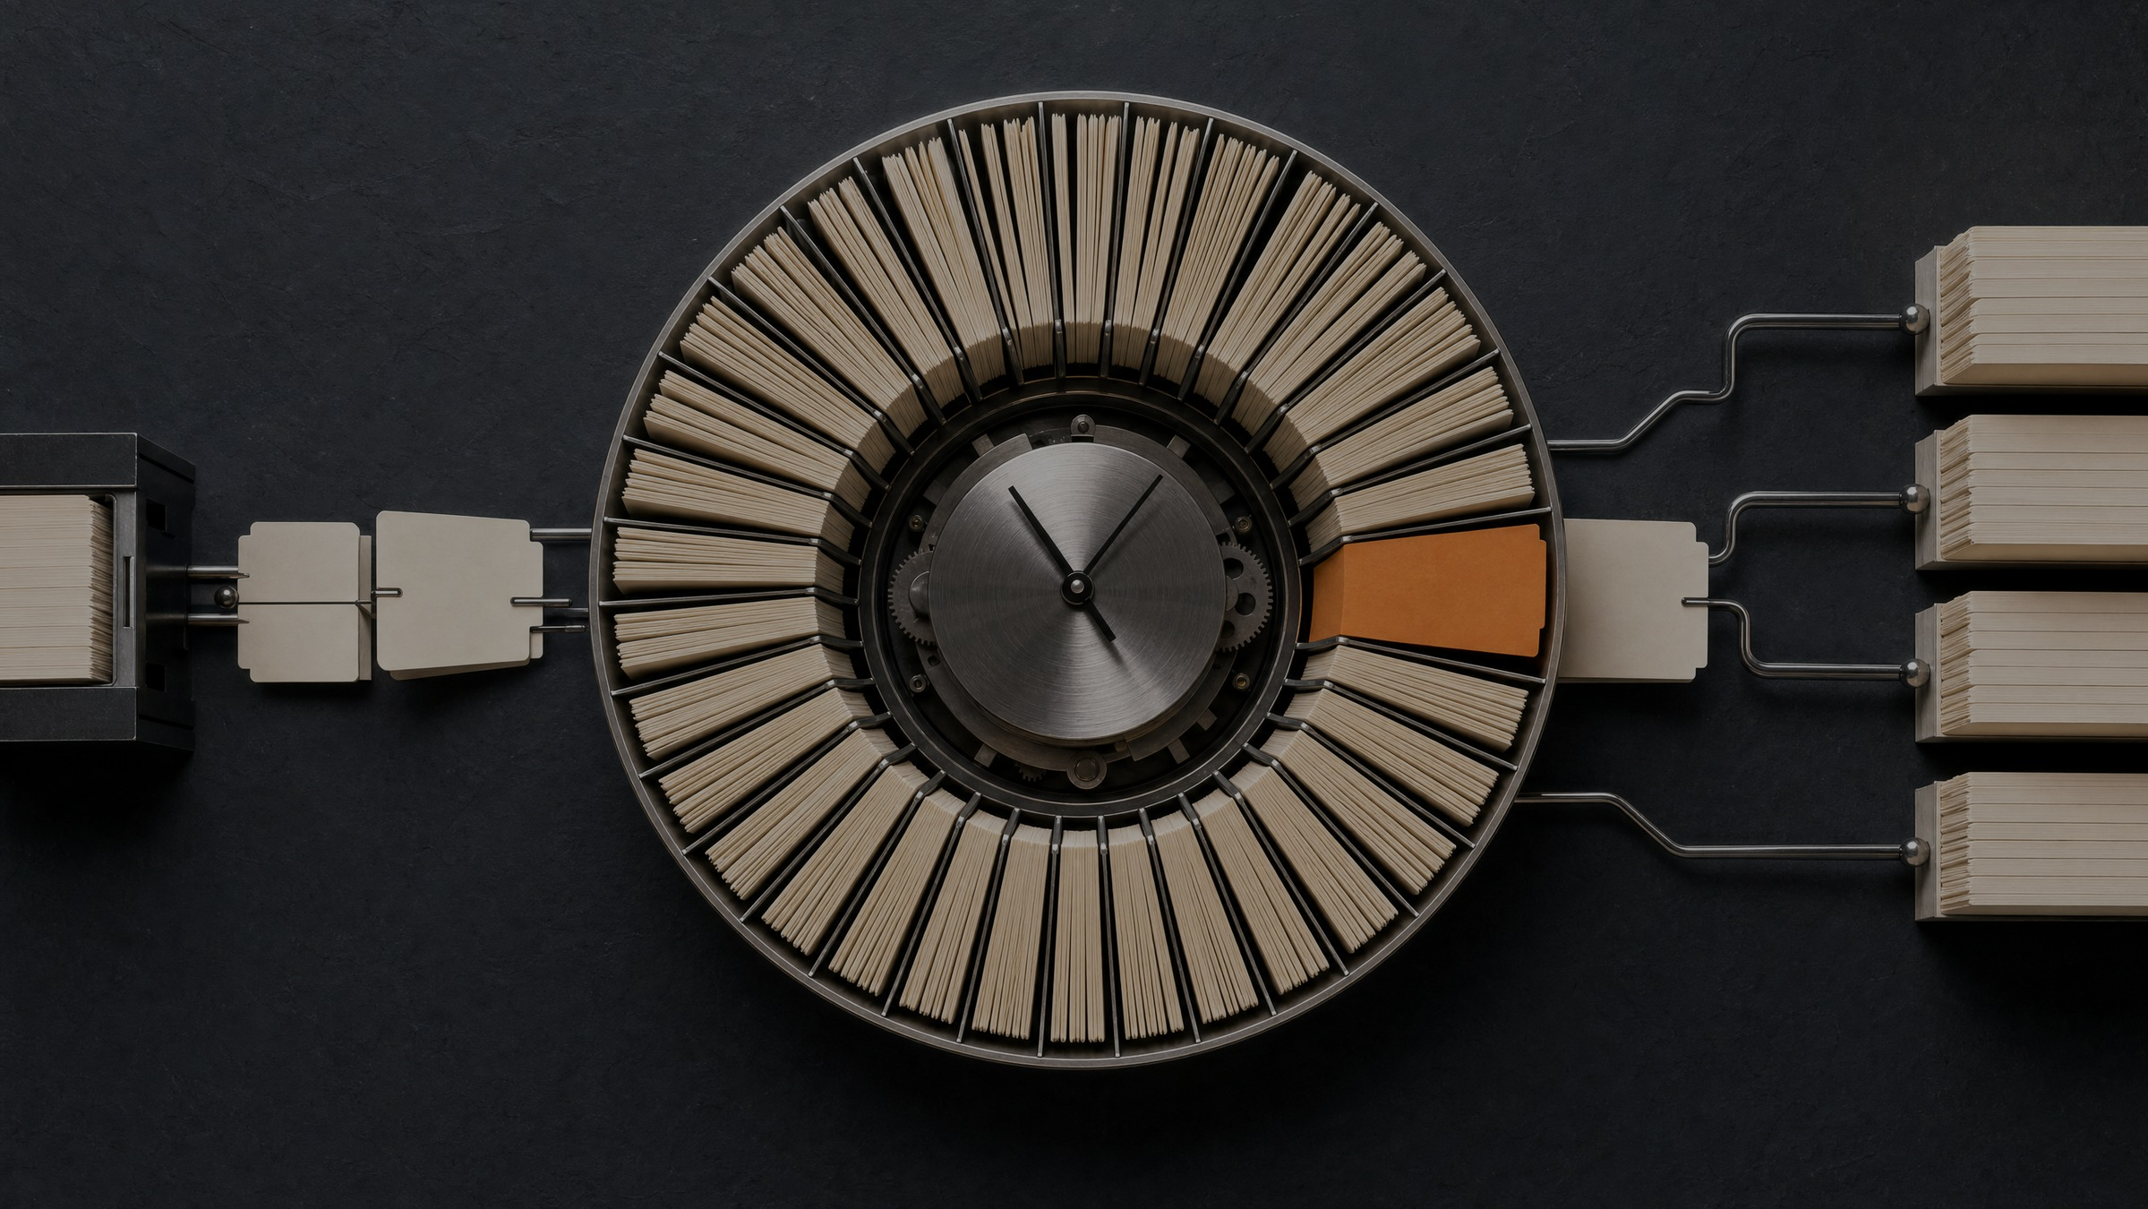
STATE
State stops the agent from
rediscovering Tuesday.
•
last successful run
•
sources reviewed
•
items already surfaced
•
open follow-ups
•
suppressed items + why
•
verification status
10
Notes:
Explain that every scheduled-task run starts in a fresh session. State is the continuity contract. It records the last run, sources reviewed, items already surfaced, open follow-ups, items suppressed and why, and verification status. Without state, the system repeatedly rediscovers the same information and calls it fresh. The suppressed list matters because it makes the attention filter auditable. It also stops yesterday's low-value item from resurfacing simply because the agent wants to be helpful.

Slide 11
ATTENTION DESIGN
Silence is a feature.
MAXIMUM
[SILENT]
3
when nothing requires attention, a decision, preparation, or a worthwhile intellectual move
items in the Daily Field Report
The system earns trust by not demanding it.
11
Notes:
This is one of the most important design decisions. The Daily Field Report is allowed to return exactly SILENT when nothing crosses the bar. It surfaces at most three items, and only when they require attention, a decision, preparation, or a worthwhile intellectual move. Content ideas usually wait for the weekly Content Board. Silence prevents the system from becoming another notification channel that slowly trains the user to ignore it.

Slide 12
MAINTENANCE
Automation watches the automation.
FAIL
DETECT
DIAGNOSE
FIX
RERUN
VERIFY
job or delivery
watchdog
bounded pass
safe + scoped
smallest proof
task + delivery
Execution success and message delivery are separate gates.
12
Notes:
A dependable agentic system needs maintenance loops. My setup includes scheduled health checks, restorable backups, scheduled-task audits, and automatic failure triage. The triage loop detects a failure, performs a bounded diagnosis, applies only safe and scoped fixes, reruns the smallest meaningful proof, then verifies both the job and the delivery path. A successful script is not enough if the scheduler still marks the run failed. A completed task is not enough if the message never arrives.

Slide 13

GOVERNANCE
7 MIN
Approval is
architecture.
We do not buy AI. We approve it.
SECRETS
TOOLS
1Password or Keychain
least privilege
EVIDENCE
EXTERNAL ACTION
facts separate from claims
human approval
Approve the bounded workflow, not the impressive demo.
13
Notes:
Connect the system design to institutional governance. Secrets belong in 1Password, Keychain, or protected environment sources, not in prompts. Each job should receive only the tools it needs. Research should separate verified facts, interpretation, and vendor claims. State changes need read-back or another verifier. Public posting, external messaging, purchases, permission changes, and destructive actions remain human-approved. We do not approve an agent because the demo is impressive. We approve a bounded workflow with named inputs, decisions, permissions, verification, and a human owner.

Slide 14
WORKSHOP
10 MIN
Design one real loop.
Choose work your team repeats at least monthly.
Name + owner
Trigger
Inputs
Context
Discovery
Decision rule
Action
Verifier
State
Notify when
Never do
Escalate when
What improves? Where could it be wrong? What stays silent?
14
Notes:
Give the room several minutes in pairs. Ask each pair to choose a recurring task their team performs at least monthly. They must identify the decision, owner, trigger, inputs, required context, discovery method, decision rule, permitted action, verifier, state, notification threshold, prohibited actions, and escalation conditions. During the debrief, ask what decision improves, where the agent could be confidently wrong, what should remain silent, what still needs human approval, and what evidence would prove the run succeeded. Improve two examples live.

Slide 15

Context.
Judgment.
Proof.
The most useful agent knows what matters, proves what it did, and leaves you alone when nothing needs you.
Questions
15
Notes:
Close with five takeaways. Start with a recurring decision, not a shiny tool. Put stable facts in context and repeatable judgment in skills. Separate collection from human-facing synthesis. Add state, verification, silence, and approval boundaries before calling it automation. Build one useful loop, observe it, then expand. The most useful agent is not the one that does the most. It is the one that knows what matters, proves what it did, and leaves you alone when nothing needs you. Then take questions.

